Slide 1
Video Matting
By Kinjal Hinsu

Slide 2
Aim

Slide 3
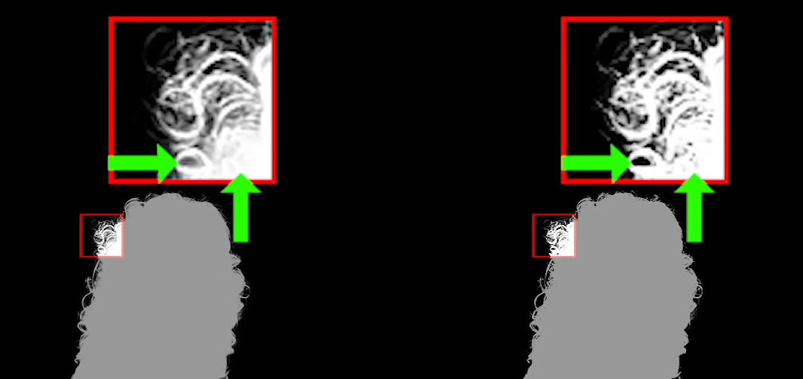

Background Removal considering:

Slide 4
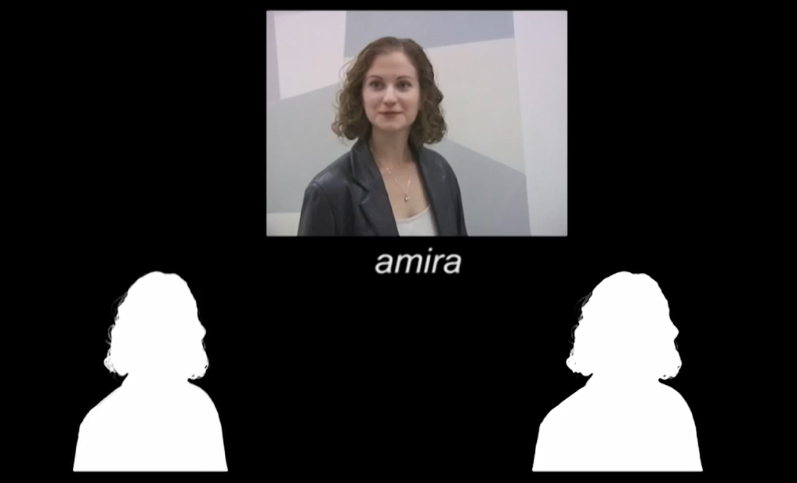

Slide 5
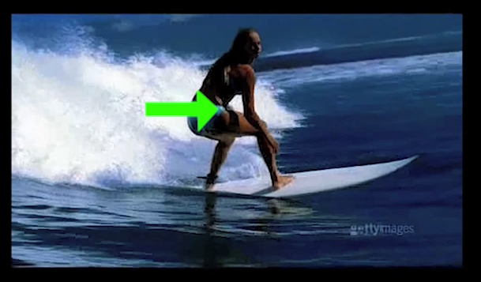
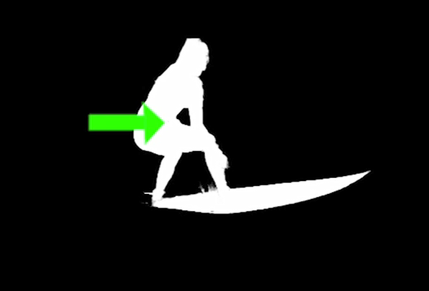
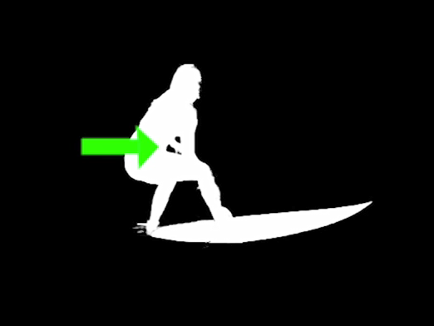

Slide 6
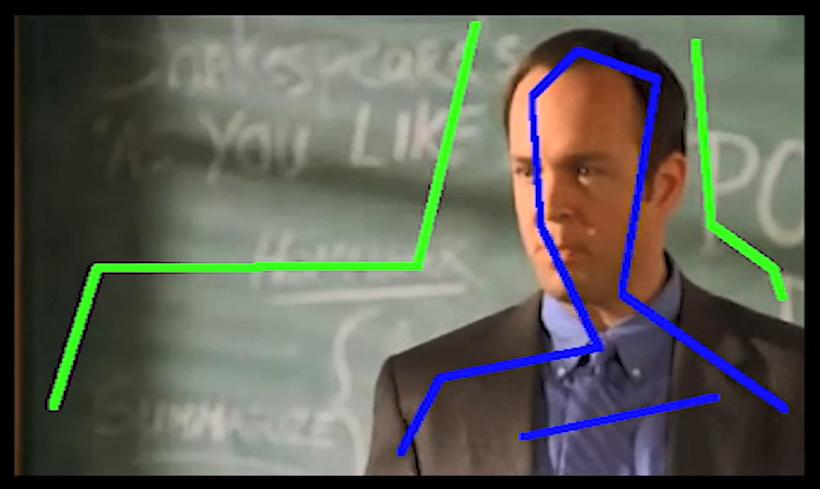


Slide 7
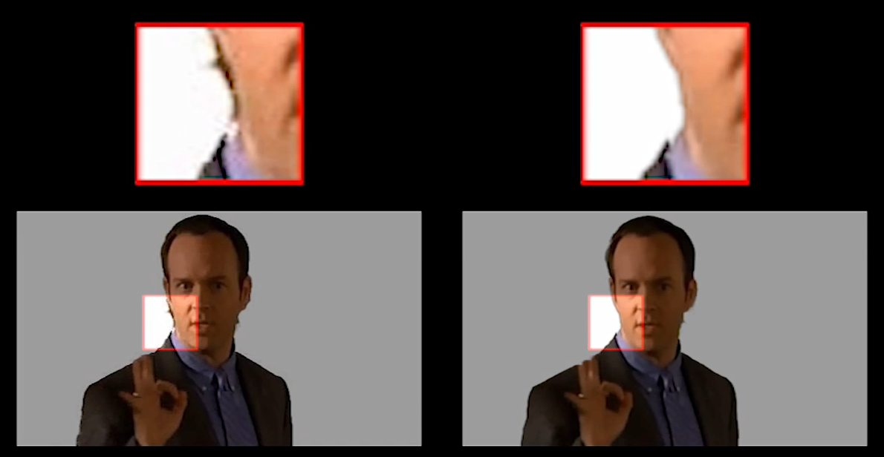

Slide 8
Journey to Solution:
Approaches

Slide 9
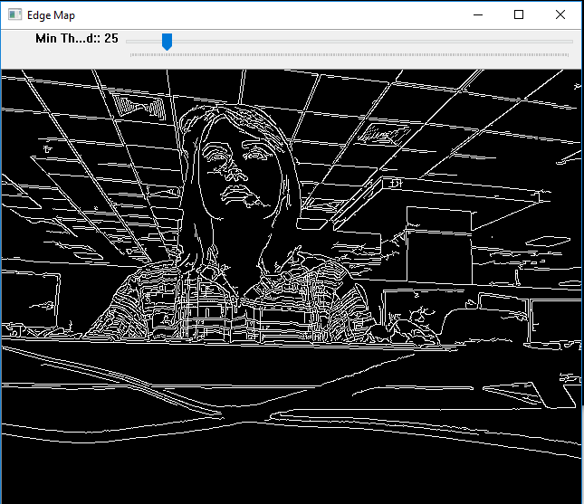
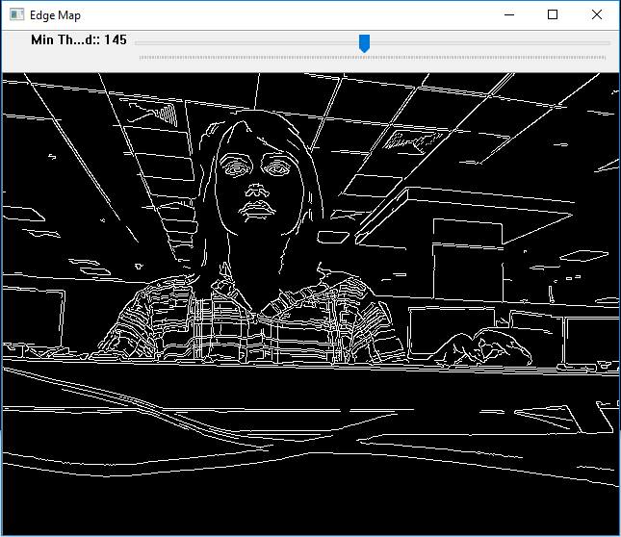
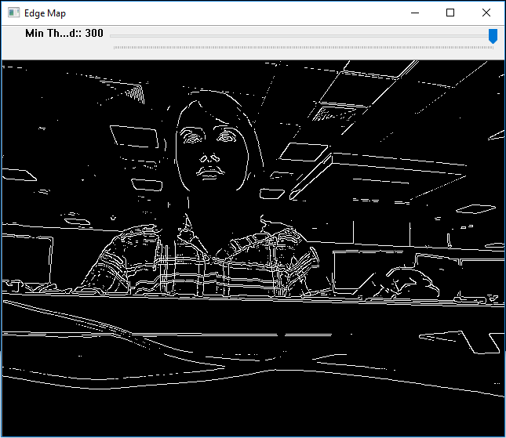
Canny Edge Detection

Slide 10
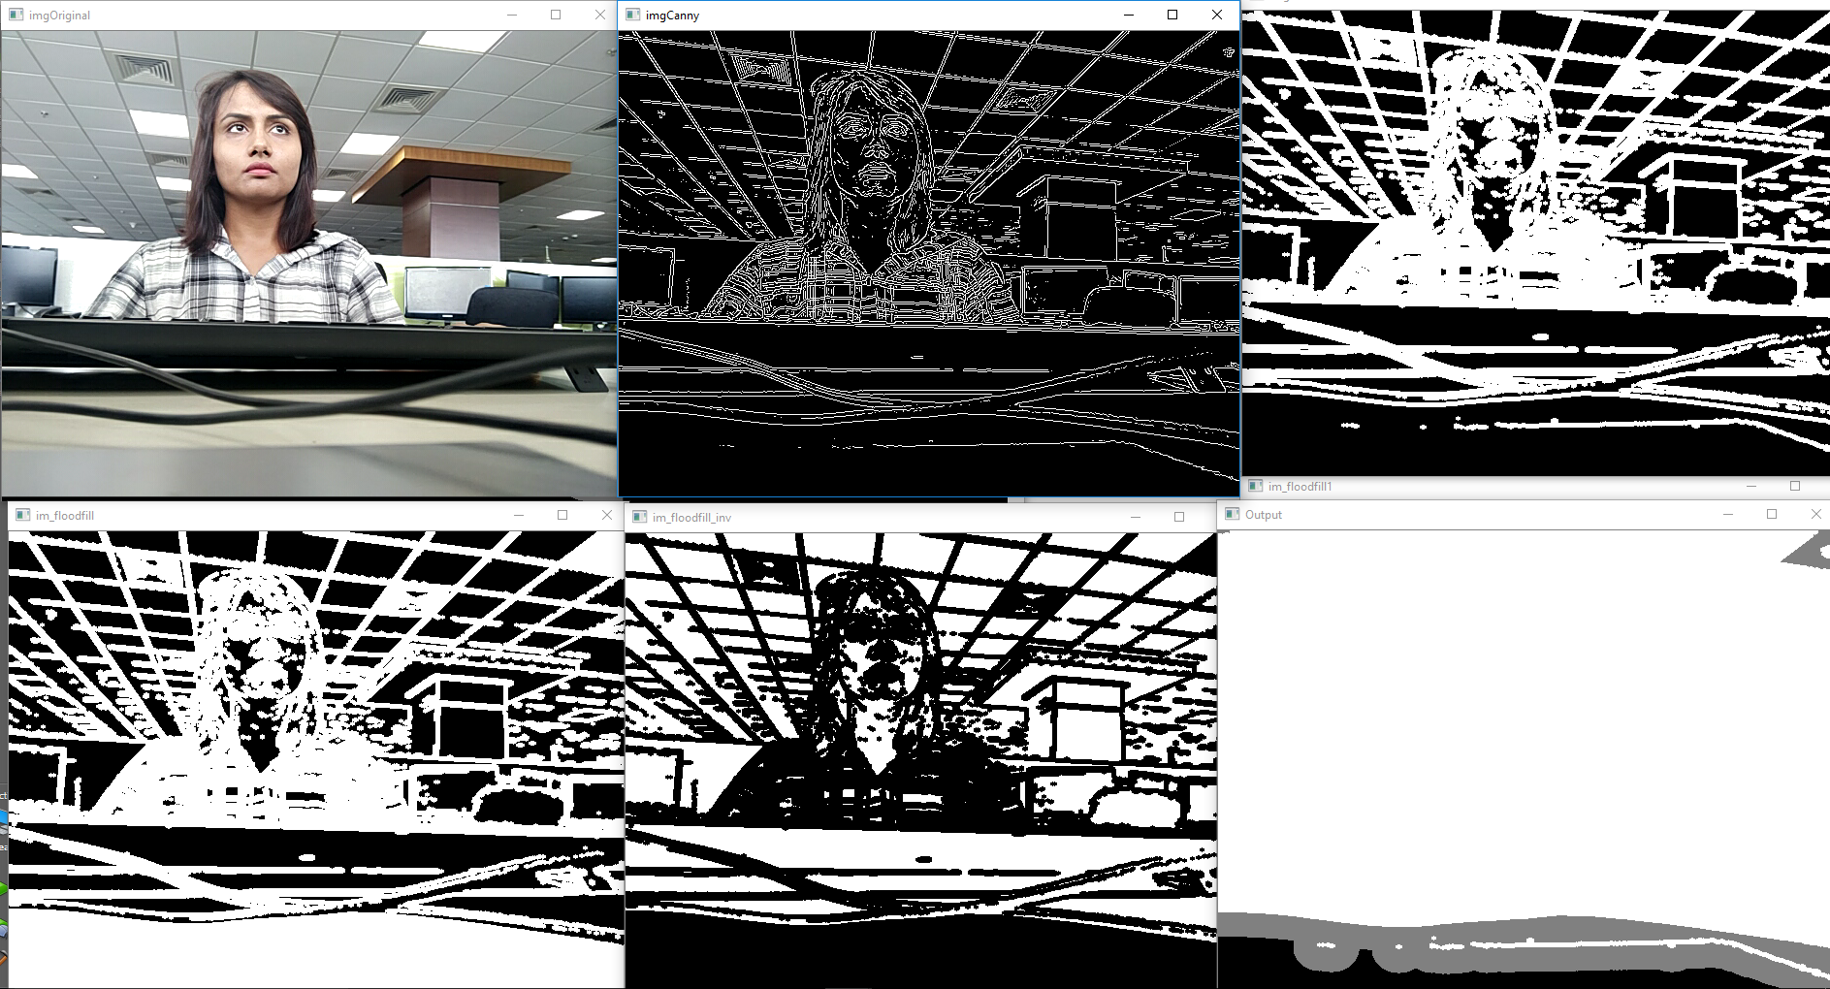
Canny
Dilate
Floodfill
Inverse the Floodfill
Combine Dilate And Inverse_Floodfill

Slide 11
Matting
Matting is the technique of estimating accurate foreground in images and video.
Accurately separating a foreground object from the background.
Foreground element is extracted from a background image by estimating a color and opacity for the foreground element at each pixel. The opacity value at each pixel is typically called its alpha, and the opacity image, taken as a whole, is referred to as the alpha matte or key.
The problem was first studied mathematically by Porter and Duff in 1984. They introduced alpha channel as the basis for linear interpolation when rendering foreground over arbitrary background.

Slide 12
Mathematically, the observed image is modeled as:
I= αF+ (1 −α)B
Where: I is the observed image α is the alpha matte F and B represent the foreground and background images respectively. The alpha matte can take any value in [0,1].
So the problem lies is in estimating these values in the images and video frames i.e. estimating the foreground, background and mixed pixels, where 7 unknown variables need to be determined from 3 known variables.

Slide 13
Video Matting

Slide 14
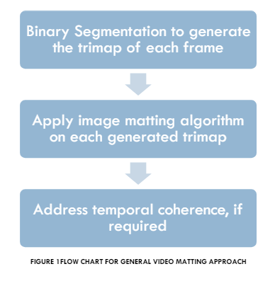
VIDEO MATTING is the technique of pulling a matte from a video sequence of a dynamic foreground element against a natural background. Video Matting to some extent requires the techniques used for Image matting but is generally much harder to implement.

Slide 15
Challenges in Video Matting:
Large Data Set
Temporal Coherence
Fast motion vs Low temporal resolution

Slide 16
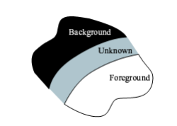
What is trimap?
Trimap is in fact is a three level pixel map which contains three types of pixels, definitely foreground, definitely background and unknown pixels. The unknown pixels are those which lie in the region separating the foreground and background objects. The trimap may be manually specified by the user or produced by binary segmentation approaches.

Slide 17
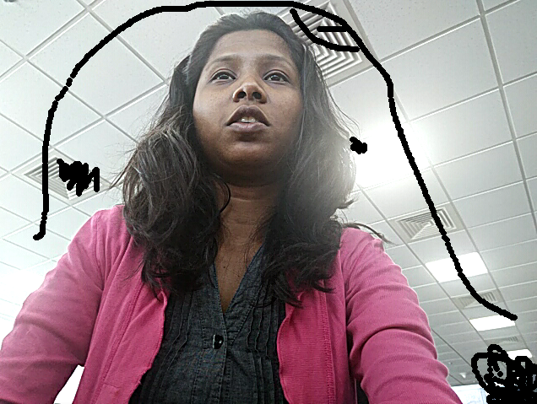
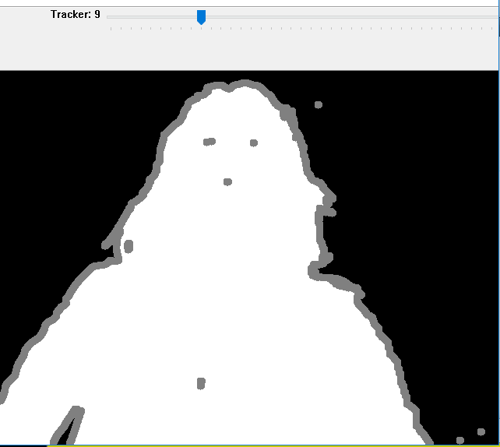
Trimap Generation Techniques
Manually Generated Trimap :
Scribbling on Foreground-Background, Grabcut will detect likely foreground-background and result in binary image, differentiating respectively.
Using Dilation-Erosion, we will get unknown region.

Slide 18
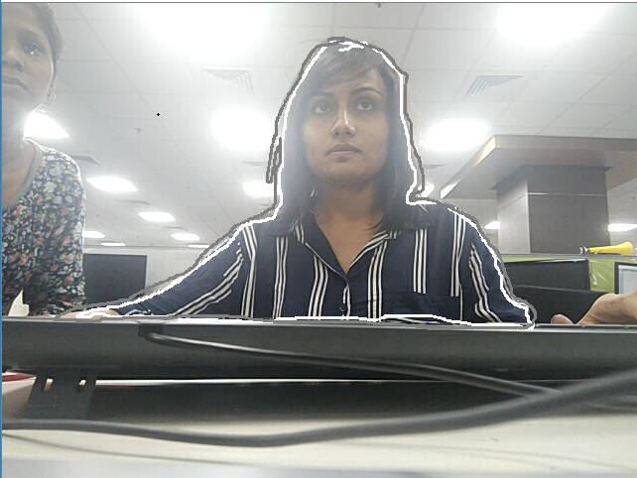
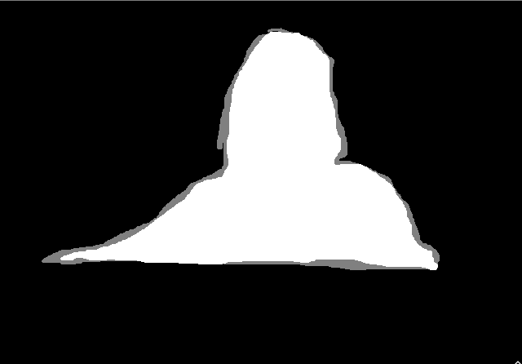
2. Marking closed foreground and unknown region and combining both
markers, assuming that remaining part is background.

Slide 19
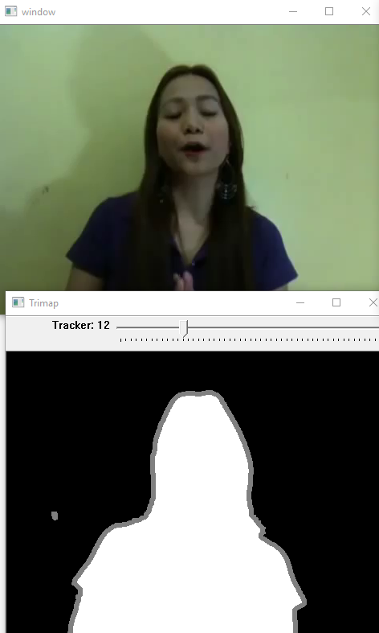
Automatically Generated Trimap:
Trimap production use iterative flood-filling procedure, limited by a simple edge detector.

Slide 20



Dilation
Erosion

Slide 21
Matting Techniques
Bayesian Matting:
Assume that our input image has already been segmented into three regions: “background,” “foreground,” and “unknown”.
The goal of our algorithm, then, is to solve for the foreground color F, background color B, and opacity α given the observed color C for each pixel within the unknown region of the image. Since F, B, and C have three color channels each, we have a problem with three equations and seven unknowns.
Building foreground and background probability distributions from a given neighborhood.

Slide 22
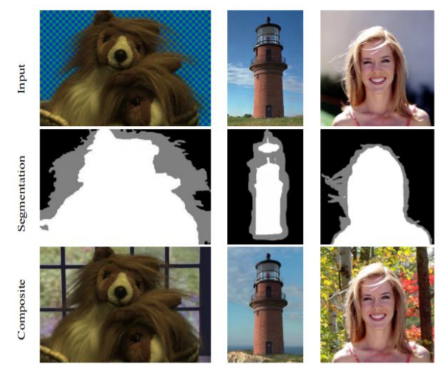
Summary of input images and results. Input images (top row. Input segmentation (middle row): conservative foreground (white), conservative background (black), and “unknown” (grey). Compositing results (bottom row): the results of compositing the foreground images and mattes extracted through our Bayesian matting algorithm over new background scenes

Slide 23
Real-Time Alpha Matting:
Our technique for real-time alpha matting is based on the fundamental observation that pixels in a small neighborhood often have highly similar values for their true (α,F,B) triplets.
Our technique takes as input an image I (or video sequence) and its corresponding
trimap(s), and consists of the following steps:
1. Expansion of Known Regions: extrapolates “known foreground" and “known background" regions of the trimap into the “unknown" regions;
2. Sample Selection and Matte Computation: tries to identify, for each pixel in the unknown regions, the best pair of foreground and background samples. It also computes an alpha matte from the obtained samples;

Slide 24
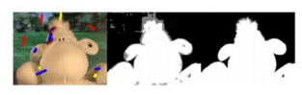
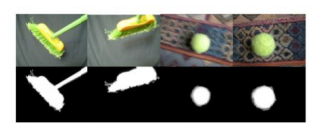
3. Local Smoothing: locally smooths the resulting matte while maintaining its distinct features.
Some frames extracted from video sequences processed by our technique for real-time matte extraction. The images on top show the original frames, while the extracted mattes are shown at the bottom.
Use of our technique to interactively segment images by alpha matting. As the user scribbles over the image (left), a trimap is automatically updated. The resulting trimap and alpha matte computed from the set of scribbles on the left are shown on the center and right images.

Slide 25
Composite

Slide 26
Compositing to get final image. We composite the extracted foreground images with a blank background to create a new image.
The basic operation as described earlier is 'alpha blending' or ‘alpha matting’, where an opacity value, 'α' is used to control the proportions of two input pixel values that end up a single output pixel.
Consider three pixels;
a foreground pixel, f
a background pixel, b
a composited pixel, c
and
α, the opacity value of the foreground pixel. (α=1 for opaque foreground, α=0 for a completely transparent foreground). A monochrome raster image where the pixel values are to be interpreted as alpha values is known as the matte.
Then, considering all three colour channels, we have:
c_{r} = αf_{r} + (1 −α) b_{r}
c_{g} = αf_{g} + (1 −α) b_{g}
c_{b} = αf_{b} + (1 −α) b_{b}
These equations together give the final composited RGB images.

Slide 27
Experimental Results

Slide 28
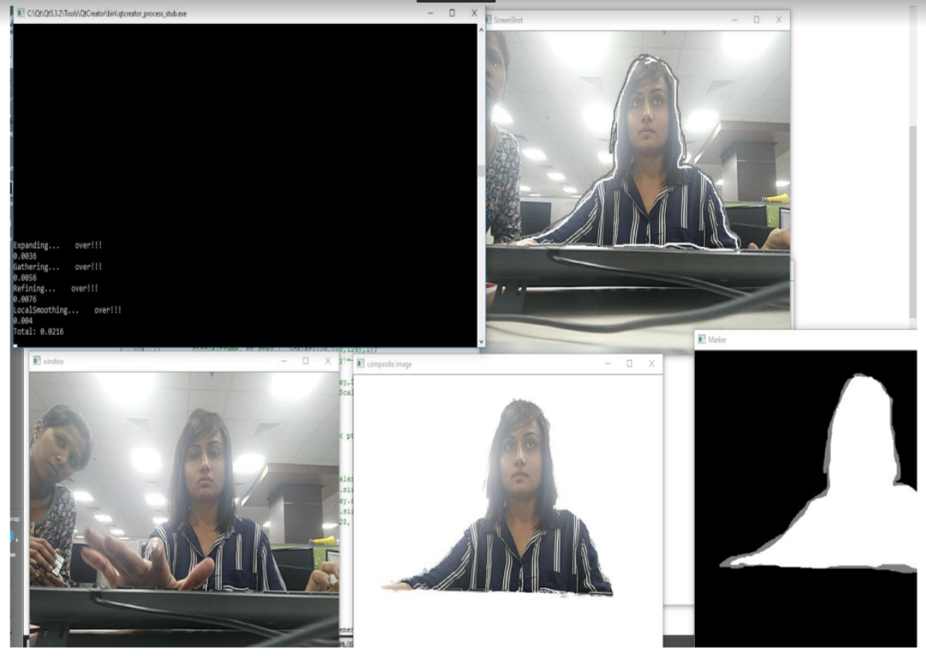

Slide 29
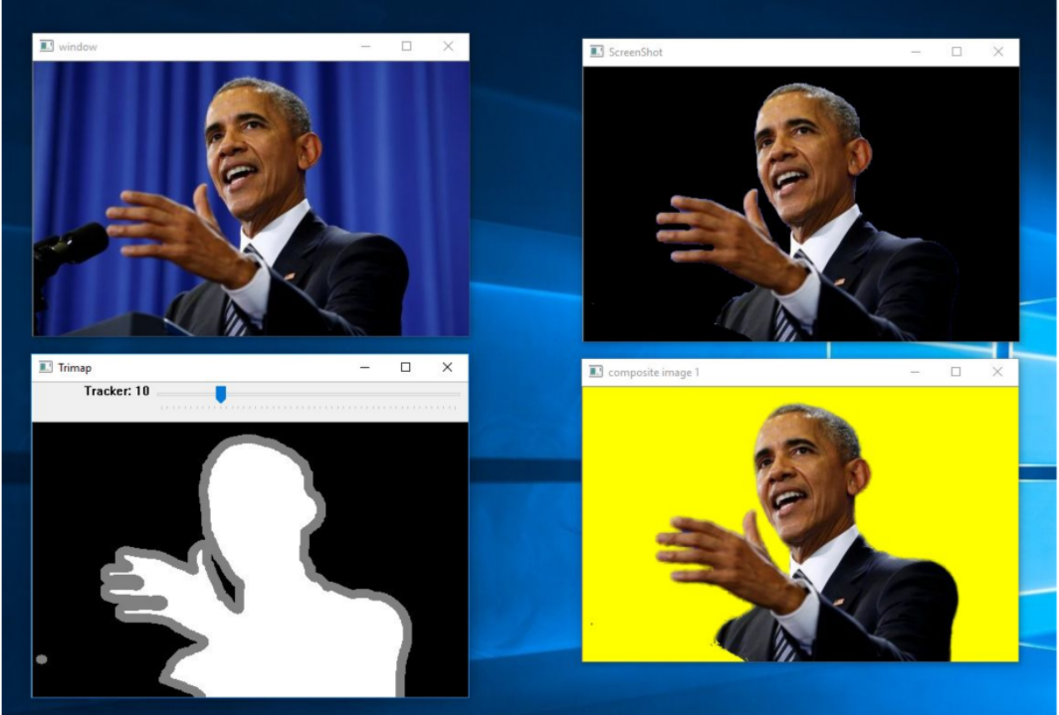

Slide 30
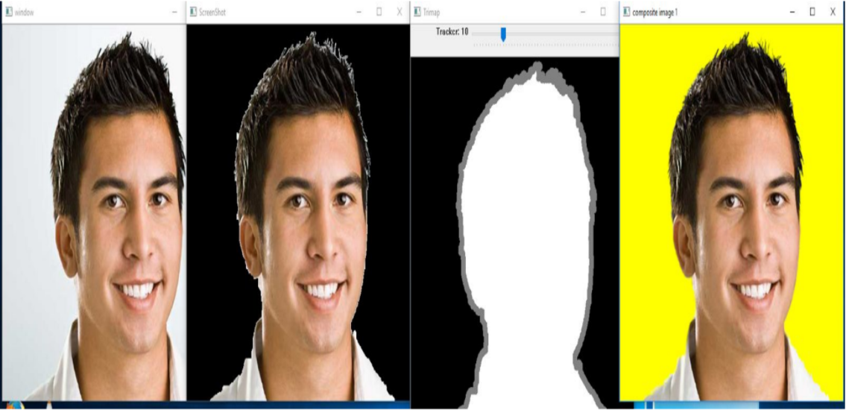

Slide 31
Conclusion
Ultimate goal of matting research is to develop intelligent, userfriendly, computationally efficient tools, which can be used to extract high quality mattes wherever the foreground and background are separable to human eyes, both on still images and video sequences.
Limitations of Current Approaches:
Accuracy
Efficiency

Slide 32
Thank You

